Slide 1
ACNS – Advanced Container Networking Services
Omer Feldman
Solution Engineer Cloud & AI, Microsoft
Yaniv Norman
Senior Solution Engineer Cloud & AI, Microsoft

Slide 2

Pain points
Why can’t my pods talk to each other?
Session latency and TCP errors
What are my DNS latencies and errors?
Visibility into high egress and cloud infra costs
Which pod or application is causing a usage spike or consuming bandwidth?
E-E traffic flows from src to dest
Customers need deep visibility to
Troubleshoot network issues for faster incident resolution
Understand and control costs
Plan resource usage and capacity
Notes:
It would be great to hear from you in the chat why your customers are looking for an observability or security solution in this space.

Slide 3






Advanced Container Network Services
Deep Traffic Insights
L4 Connection Metrics
DNS
FQDN Filtering
Network Flow logs
And more..
Powered by eBPF technology

Slide 4

eBPF-Powered Observability with Retina
What is eBPF?
A Linux kernel technology that allows safe and efficient execution of custom code within the kernel.
eBPF programs run directly in the Linux kernel, providing deep observability without context-switching overhead.
Coming to Windows soon
Why eBPF is Ideal for Cloud-Native Environments?
Low Overhead
Granular Visibility
Security & Isolation
Scalability
Notes:
Low Overhead: eBPF operates in the kernel, minimizing performance overhead for monitoring and observability, unlike traditional sidecar models.
Granular Visibility: eBPF can hook into various kernel events (network, security, system calls), offering a fine-grained, real-time view of network behavior.
Security & Isolation: eBPF’s secure execution model ensures that programs can inspect traffic, enforce security policies, and perform actions without exposing vulnerabilities.
Scalability: Efficiently handles high traffic loads and scales with Kubernetes clusters by dynamically monitoring network packets.

Slide 5
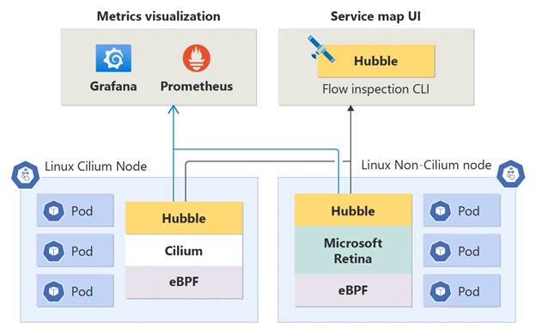
Observability Architecture and capabilities
Power of Hubble’s control plane to both Cilium and Non-Cilium Linux data planes.
Supported on any CNI
Emits metrics into industry-standard Prometheus Metrics with Grafana visualization
Notes:
- Hubble Metrics, CLI, and UI integration
Visualization is through Grafana dashboards but you also have the option to use Hubble UI to see service dependencies.

Slide 6
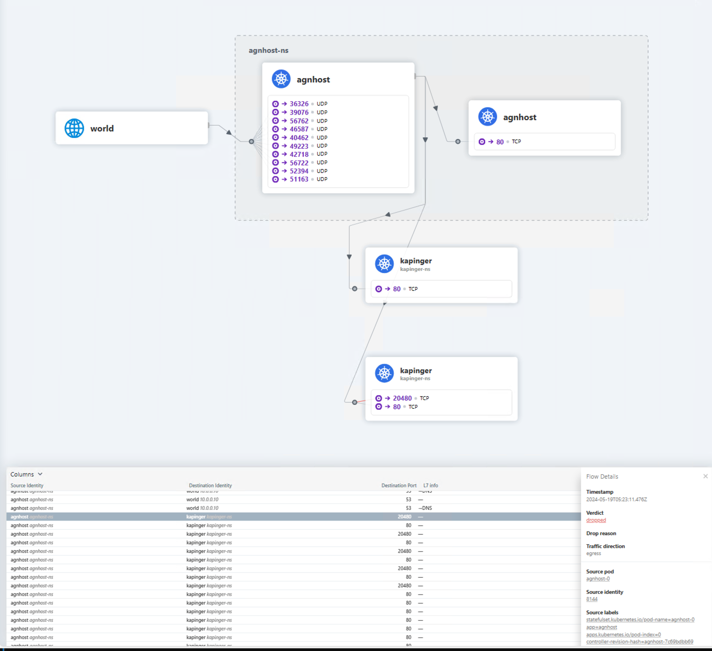
Service Dependency Graphs
Hubble UI for visualizing and filtering of dataflows as a service map
On-demand view of flows across the cluster.
Visually mapped insights of network flows within the cluster.
Supported on both Cilium and Non-Cilium clusters
Notes:
You can enable Hubble UI in ACNS as an option. Hubble UI is a user-friendly browser-based interface for exploring cluster network activity. It creates a service-connection graph based on flow logs so you can easily view service dependencies.

Slide 7
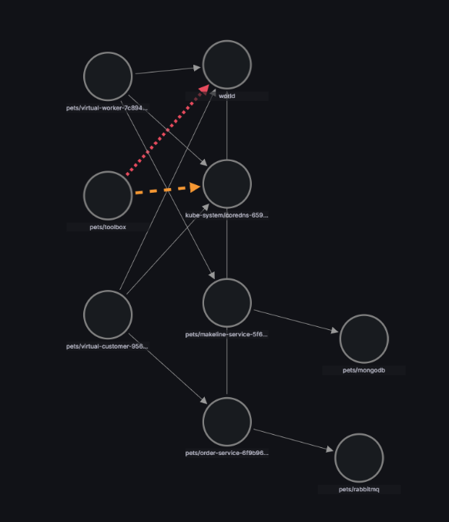
Container Network Logs Visibility that Drives Action
Public Preview
Pod level network flow logs exported to Azure monitor or BYO storage
Rapid Troubleshooting: Diagnose failures,
dropped packets, and misconfigurations quickly with pod-level L3–L7 insights and service maps.
Service maps: Visualize connectivity for quick troubleshooting
Compliance Made Simple: Maintain detailed traffic logs to stay audit-ready with minimal effort.
Cost Efficiency: Smart log filtering ensures only
relevant data is collected, cutting noise and storage costs.
https://aka.ms/ContainerNetworkLogsDoc

Slide 8
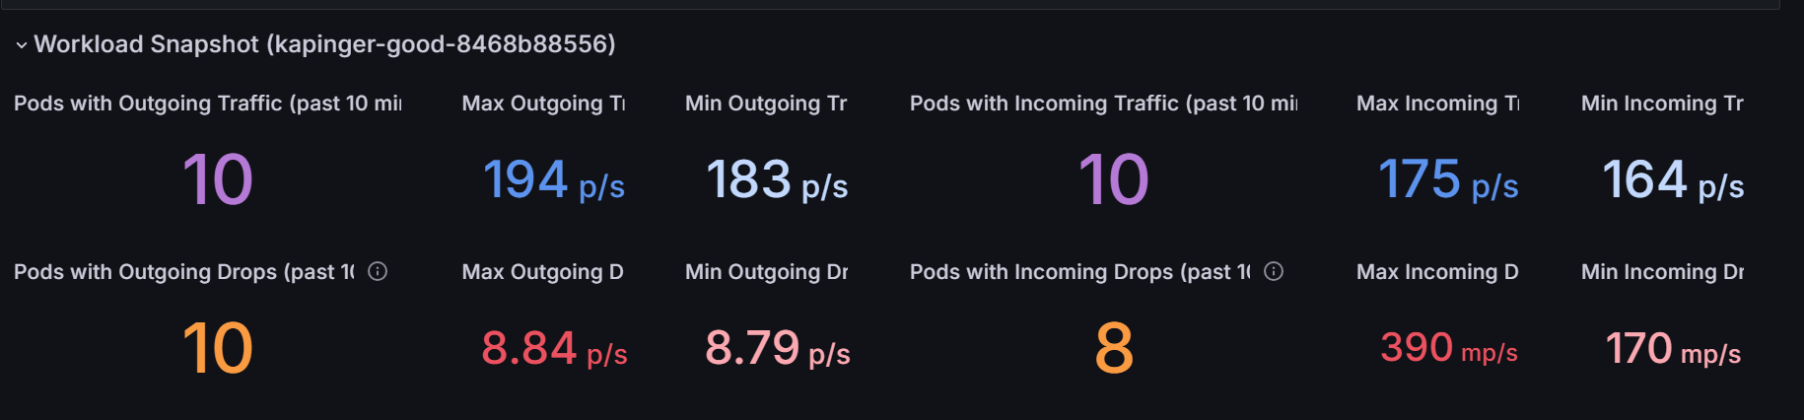
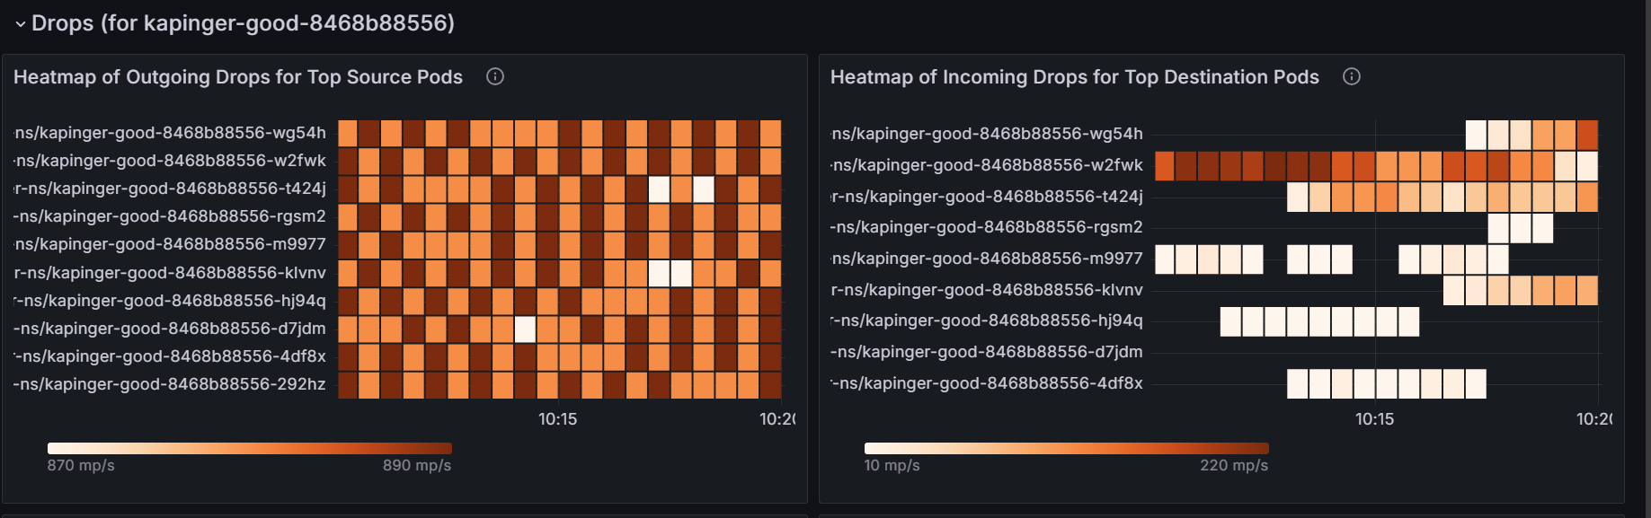
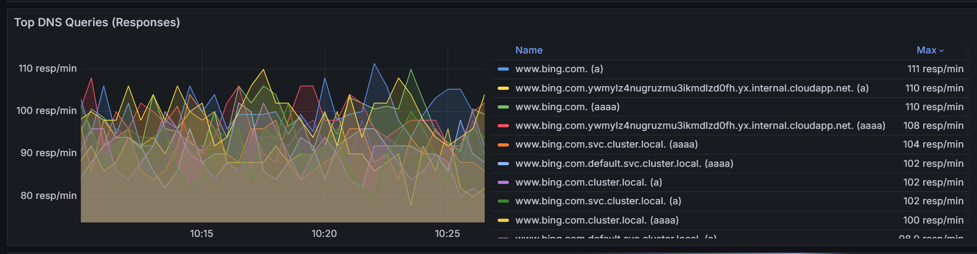
Pod/Node level metrics
L4, L7 (DNS) metrics at Pod level
Drop metrics with reason at Pod level
TCP/UDP Connection stats
VM Interface health statistics
Notes:
- What is the TCP/UDP and DNS statistics or utilization at the workload, namespace or Pod level
Heatmaps for all the pods in a namespace
Dropped packet statistics
TCP – connection errors, resets etc

Slide 9
ACNS Container Network Metrics Filtering
Public Preview
Targeted pod level metric generation to reduce storage cost
Filtering: Based on namespace, pod ids, labels, Protocols and Verdict at the source
Reduce noise and cost : Collect only relevant metrics
Higher fidelity dashboards: Better clarity and troubleshooting speed
apiVersion: acn.azure.com/v1alpha1
kind: ContainerNetworkMetric
metadata:
name: container-network-metric
spec:
filters:
- metric: tcp
includeFilters:
- from:
namespacedPod:
- "traffic/fortio-client"
to:
namespacedPod:
- "traffic/fortio-server"
excludeFilters:
- from:
namespacedPod:
- "kube-system/"
- to:
namespacedPod:
- "kube-system/"

Slide 10
AKS Defense in depth: In-Cluster L3–L7 Security
GA
Use Advanced container networking services on Cilium to simplify Kubernetes network security and policy management
apiVersion: cilium.io/v2
kind: CiliumNetworkPolicy
metadata:
name: allow-backend-egress-to-blobstorage
namespace: default
spec:
endpointSelector:
matchLabels:
app: backend
egress:
- toFQ:
- matchName: app1.myblobstorage.com
- toPorts:
- ports:
- port: "53"
protocol: ANY
rules:
:
- matchPattern: "*.myblobstorage.com"
apiVersion: cilium.io/v2
kind: CiliumNetworkPolicy
metadata:
name: allow-http-ingress
namespace: default
spec:
endpointSelector:
matchLabels:
app: frontend-app
ingress:
- fromEndpoints:
- matchLabels:
app: backend-app
- toPorts:
- ports:
- port: 80
protocol: TCP
rules:
http:
- method: "GET"
path: "/api/v1/*"
Network policies:
Enables granular, identity-aware traffic control for workloads (L3–L7)
Delivers cluster-wide protection with streamlined operations
Supports FQDN-based filtering and Layer 7 policies, available via ACNS
L7 Policy
FQDN Policy

Slide 11
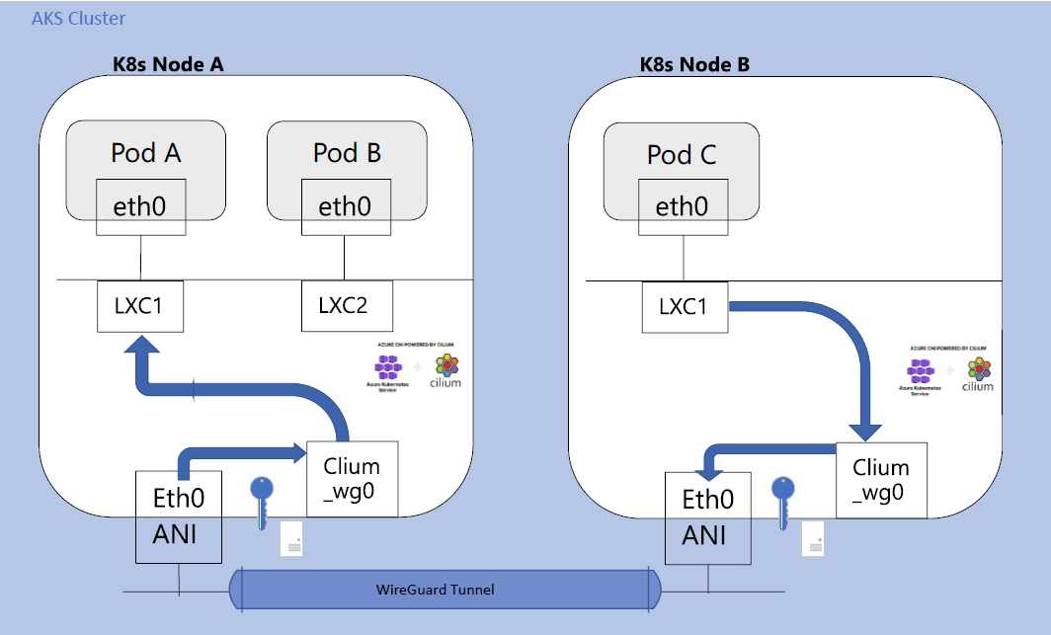
WireGuard - In-Transit Encryption for AKS
Public Preview
WireGuard offers a simple and efficient method to encrypt traffic between Cilium-managed endpoints across nodes within the same AKS cluster.
Secure Node-to-Node Traffic: Encrypts all in-transit traffic between cluster nodes.
Application transparent: No code or configuration changes required in workloads
Simple Setup: Enable with a few flags; no complex steps.
Managed Key Lifecycle: AKS handles key rotation and distribution automatically.

Slide 12
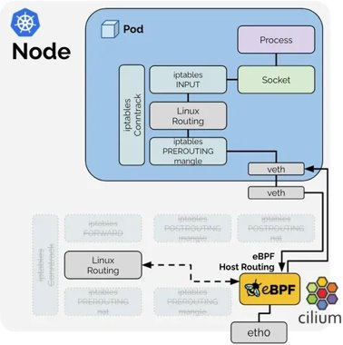
Public Preview
Application performance : ACNS datapath acceleration
Designed for high-throughput microservices, real-time apps, and AI/ML workloads in large AKS clusters leverage eBPF for next-gen networking performance
Lower Latency: Reduced packet processing layers → faster pod-to-pod communication.
Higher Throughput: Optimized datapath for inter-node traffic.
Reduced CPU Usage: Offloads SNAT and routing logic from iptables to eBPF programs.
https://aka.ms/acnsperformance
Source: https://cilium.io/blog/2021/05/11/cni-benchmark/

Slide 13
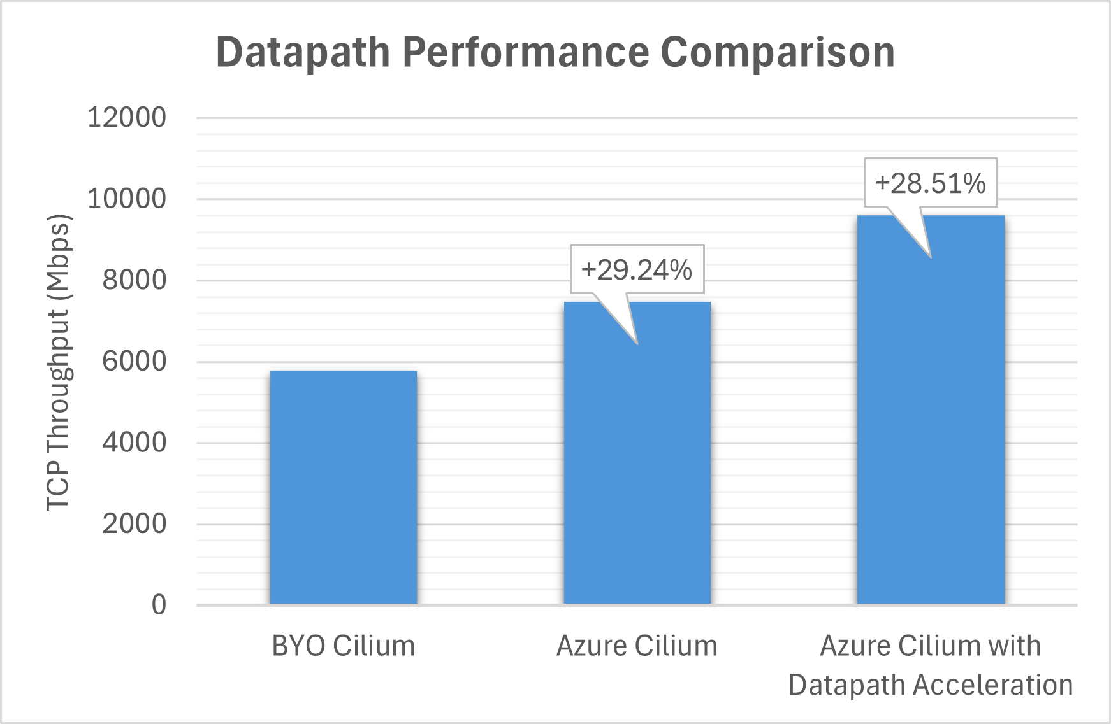
Azure Managed Cilium -Driving High-Performance Kubernetes Networking
Natively integrated with Azure CNI networking modes to offer high performance and scale
High performance -No double encapsulation, native support for hardware offloads
New Advanced Container Networking Service features
Security
L3-7 network policies (GA)
Encryption (PP)
Observability
Filtered metrics, flow logs (PP)
Performance acceleration (PP)
Accelerating AI workloads with nearly 30% higher throughput
Trusted for the largest, most mission-Critical production deployments
Notes:
Accelerating AI workloads with nearly 30% higher throughput 1) Customer Problem
Modern containerized applications and AI workloads demand high-performance networking, strong security, and deep observability. Traditional solutions often introduce overhead like double encapsulation, lack advanced policies, and struggle to scale efficiently.
2) Our Solution
Azure’s Advanced Container Networking Service is natively integrated with Azure CNI networking modes to deliver:
High Performance: No double encapsulation, native hardware offload support
Security: Layer 3–7 network policies (GA) and encryption (preview)
Observability: Filtered metrics and flow logs (preview)
Performance Acceleration: Nearly 30% higher throughput for AI workloads
3) Benefit to Customers
Customers achieve faster, more secure, and scalable container networking, improved visibility for troubleshooting, and accelerated AI performance—enabling them to run cloud-native and AI workloads with confidence and efficiency.

Slide 14
ACNS Timelines & Pricing
ACNS Public Preview
FQDN Filtering
ACNS GA
June 2024
September 2024
November 2024
Feature | Price
Advanced Container Networking Services | $0.025 per node per hour
https://azure.microsoft.com/en-us/pricing/details/azure-container-networking-services/

Slide 15
Demo

Slide 16
Workshop

Slide 17
Bootstrap the environment
The workshop Git repository is in the following link: ACNS Workshop
Make sure you follow the the Readme file and preforming the instructions to create the workshop environment.
View the resources created in your Azure tenant.

Slide 18
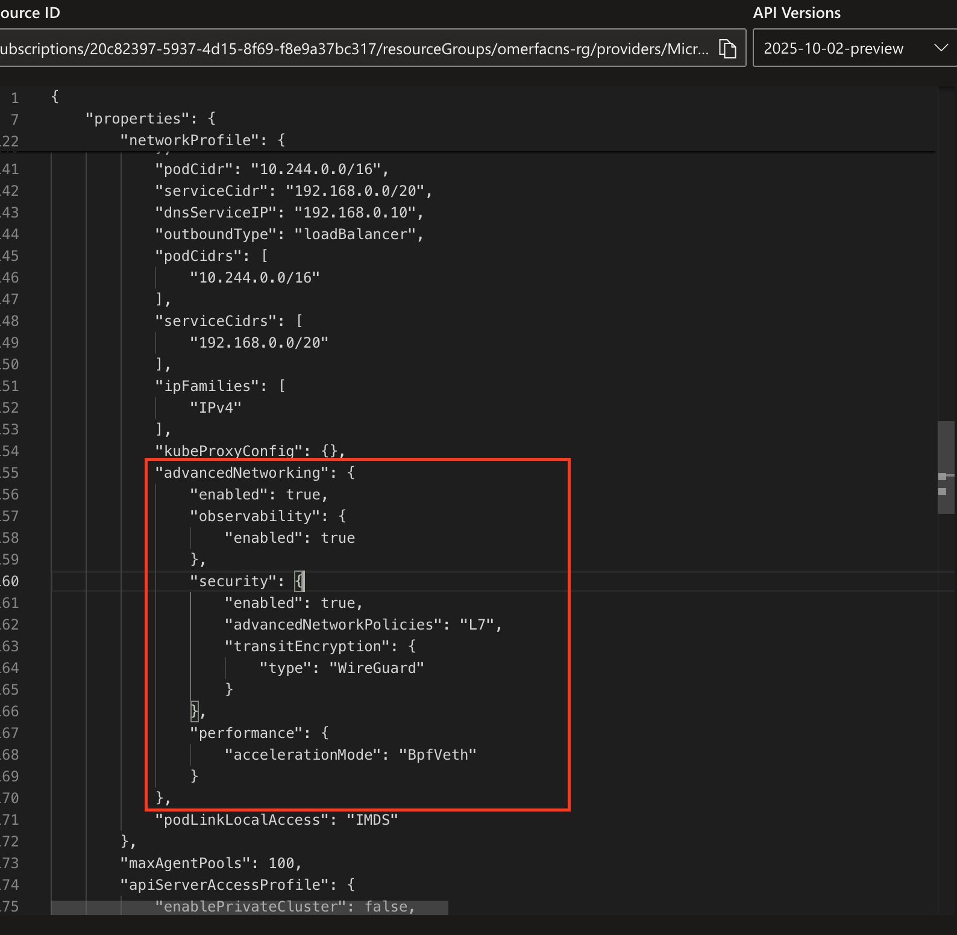
Get to know the environment
Once everything has been created, you will have a running AKS cluster with two applications running (frontend & backend), in addition Hubble UI Service.
Both Frontend and Hubble are public facing via AKS service LoadBalancer, you can find the PIPs from the portal.
The frontend application includes a UI for testing connections toward the backend application. The Backend application contains 3 routes (/allow, /deny, /health), you can call these endpoints from the Frontend bottoms.
In addition, open the JSON view of the created AKS and switch to the newest API Version, look for the AdvancedNetworking field, you should see result like the example, which verifies that ACNS is enabled along with all its features

Slide 19
Step 1
Open the Hubble UI, explore it possibilities. In parallel preform some calls from the Frontend to the backend (via the bottoms) and see the insights you gain from Hubble.
Try to find the service dependency graph, and the view some of the requests that can be found in the below table
Once you finished, move to the next step.

Slide 20
Step 2
As we learned, the Hubble data is not persistence and won’t be shown once a refresh to the Hubble UI will occur.
To have persistency, you will have to create a ContainerNetworkLog CR, that will be resulted in capturing the flow logs data and store it inside Azure monitor.
So, create two new ContainerNetworkLog CRs:
To capture all the ingress traffic towards the frontend application
To capture the ingress traffic towards the backend application from the frontend application
Notes:
The Frontend Application runs inside namespace called frontend-ns with label of app: frontend
The Backend Application runs inside namespace called backend-ns with label of app: backend
In the next slide, you will find a template for the mentioned ContainerNetworkLog CR.

Slide 21
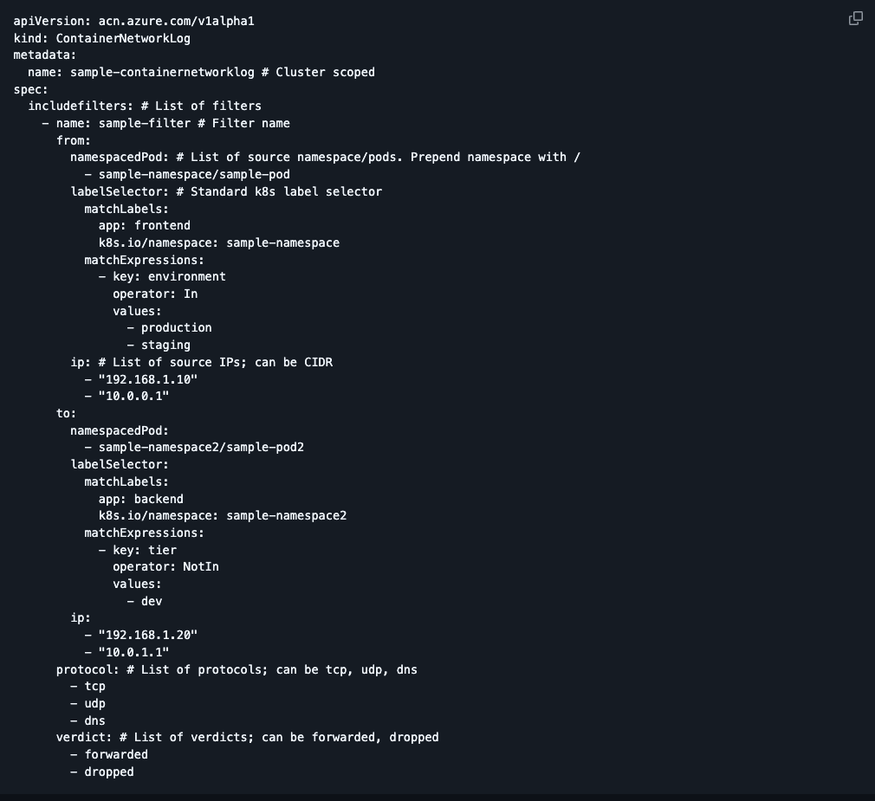
Step 2 - Continue
After you have finished, please provision two new dashboards to the created Grafana that can be found in the following links:
Flow Logs Dashboard
Flow Logs External Dashboard
You can follow the Guide in the Readme file for the steps needed to import a dashboard: Import Grafana Dashboard
Once the dashboards are provisioned, look the insights there. In addition explore the insights in the following dashboards: ”Kubernetes / Networking / Pod Flows (Namespace)”, “Kubernetes / Networking / Pod Flows (Workload)”

Slide 22
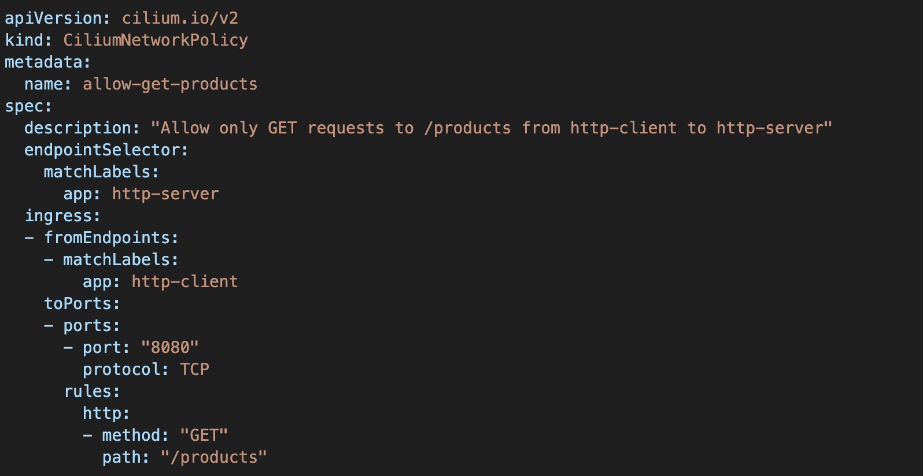
Step 3
Great progress, now we will focus on implementing L7 policies.
L7 policies defines how particular workloads within your AKS can communicate with each other.
1. Create two L7 policy that allows connection to the backend workload only from the frontend workload at port 8000 and only GET to /allow & /health (one from the backend perspective, and second from the frontend perspective)
Reference the L7 CR example
After you have deployed the L7 policy, Test the Frontend actions, view the Hubble UI and the Grafana insights - look for dashboard named: “Kubernetes / Networking / L7 (Namespace)”

Slide 23
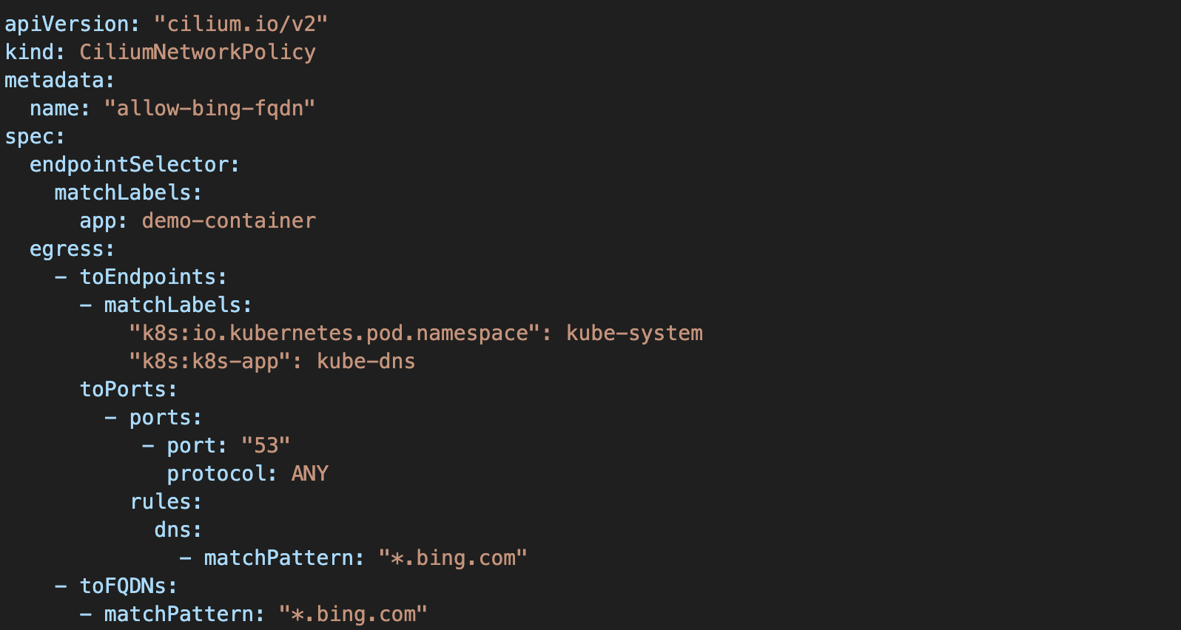
Step 4
Now let's improve our Network policies,
Add to the previous step backend policy a DNS + FQDN filtering: allow the egress traffic (L7 + DNS) from the backend workload to be allowed only to ”*.microsoft.com” & “microsoft.com”
Reference the L7 CR example
After you have deployed the edited L7 policy, Test the Frontend action to the /allow route and see the response has been changed, view the Hubble UI and Grafana insights look for dashboard named: “Kubernetes / Networking / DNS (Cluster)”, “Kubernetes / Networking / Drops (Workload)”

Slide 24
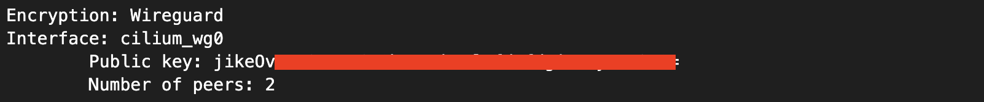
Step 5
In this step, we will verify the WireGuard Encryption In Transit is running, WireGuard gives us Encryption In Transit for the traffic between the K8S nodes without changing nothing from application perspectives.
Preform the following commands:
1.
2.
The response should look like:

Slide 25
Step 6
Now let's verify the performance enhancements that we get from the eBPF host routing capability
Run the following command: kubectl get pods -n backend-ns -o wide, take the pod IP and save it
Preform kubectl exec command into each pod (frontend & backend) in separated terminals using: kubectl exec -it <POD_NAME> -n <NAMESPACE_NAME> -- bash
Run the following command in each terminal: apt update && apt install -y iperf3
In the Backend Pod, run the command: iperf3 -s
In the Frontend Pod, run the following command: iperf3 –c <BACKEND_POD_IP> -P 5 –t 5 where BACKEND_POD_IP is the output pf the command in phase 1, this command will preform 5 performance tests and will give you the results
Continue the instructions in the next slide

Slide 26
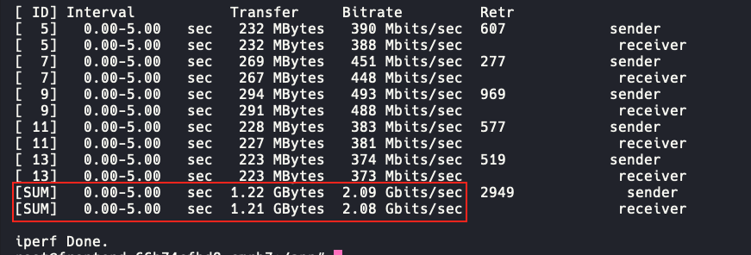
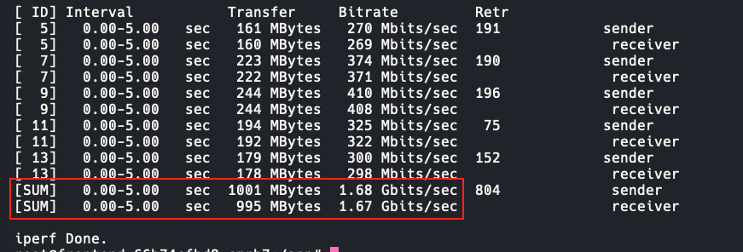
Step 6 - Continue
With eBPF
6. Look at the output of the iperf3 command in the frontend pod, you should see something like: In this performance test example, we have achieved ~2.08Gb/s
If we would preform the exact same test we would achieve lower performance, attached is a test made without eBPF host routing:
WireGuard Encryption In Transit adds latency, in the next slide you will be able to see the same performance tests without it
To test it yourselves, run the following command:
Without eBPF
az aks update --resource-group <RG_NAME> --name <AKS_NAME>--enable-acns --acns-datapath-acceleration-mode NONE --acns-transit-encryption-type 'WireGuard' --acns-advanced-networkpolicies 'L7'

Slide 27
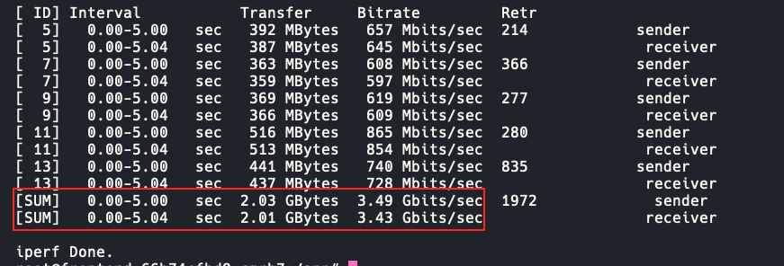
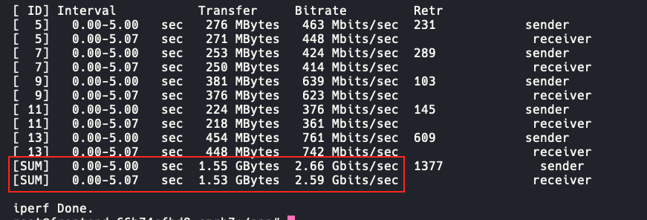
Step 6 - Continue
Without WireGuard
With eBPF
Without eBPF
31% higher throughput

Slide 28
Thanks!

